Slide 1
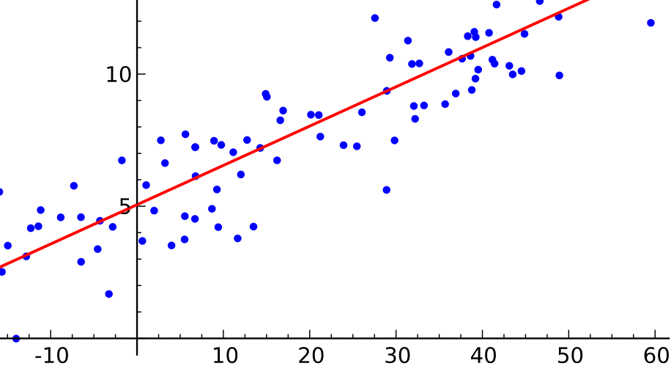
CRSS (PBGG) 8010:
Research Methods and Design in Crop Science
Jason Wallace Fall 2026
Lecture 15
Linear Regression II

Slide 2
Lecture outline
Administrative stuff
Review of last time
Unpacking linear regression models
Linear Regression assumptions
Testing your assumptions

Slide 3
Administrative stuff
Midterm 1 response due now

Slide 4

Review:
Linear Regression
Your friend in Astronomy is testing 3 algorithms to remove satellite tracks from images of near-earth asteroids (“15_asteroids.csv”).
  “tracks” is the number of tracks remaining after cleaning
For 1 week, each night is divided into 6 hours, and each algorithm randomly assigned one observation window in the 1st half of the night and another in the 2nd half.
  What kind of design is this?
  Run ANOVA using both aov() and anova()
    Confirm that the results are the same for each factor
  Which algorithm(s) should they use?
NASA

Slide 5
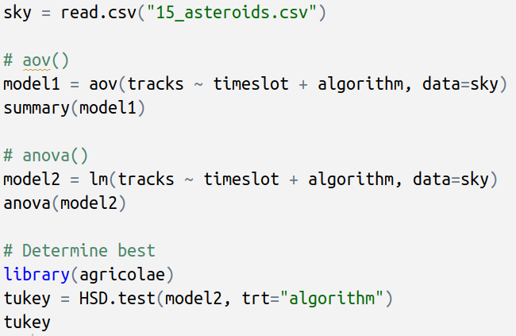
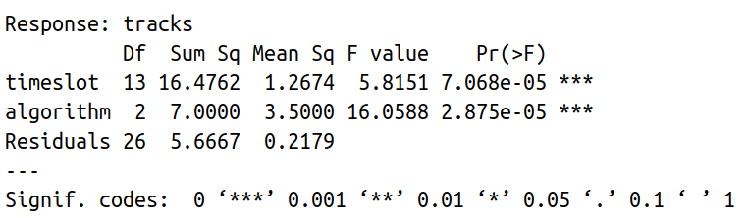
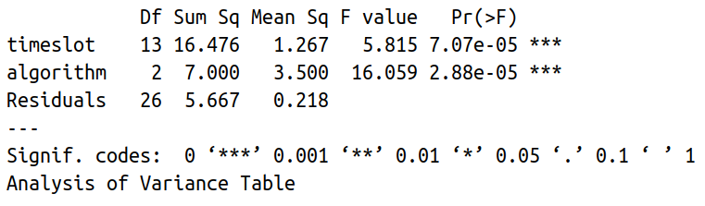
Review:
Linear Regression
Note: RCBD design
(each window = 1 block)
Identical results

Slide 6
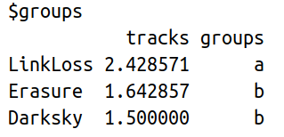
Review:
Linear Regression
Can use either aov() or anova() output
[Skipping most output]
Best two (because want to remove tracks)

Slide 7
Questions on linear regression so far?

Slide 8
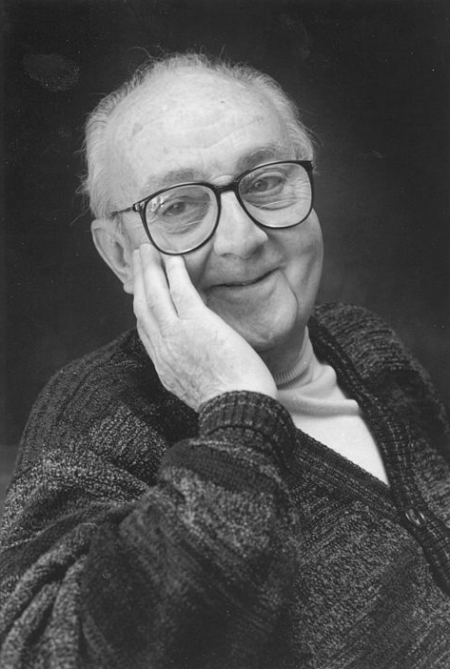
What is a statistical model?
“All models are wrong, but some are useful.”
- George Box (statistician)
Our analyses involve fitting data to some sort of model (ANOVA, linear regression etc.)
The model is our attempt to explain data
Think of models as hypotheses: our best guess, but not the final word
Photo by David M. C. Eddy (Wikimedia)
Notes:
Photo is of George Box

Slide 9

What a model actually means
When we fit a linear model to data, we are trying to determine the effect each model term has.
Example: Berry yield in raspberries
  4 varieties in RCBD, each block in a
  different field

Slide 10
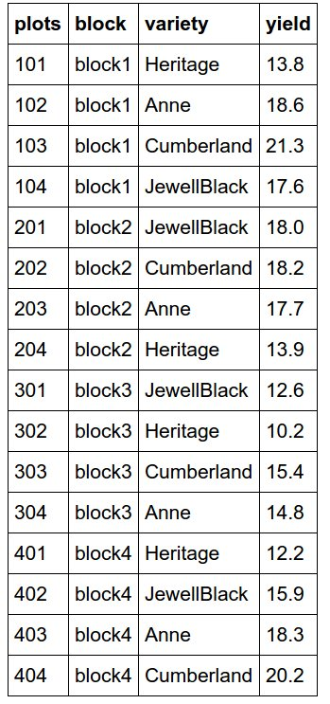
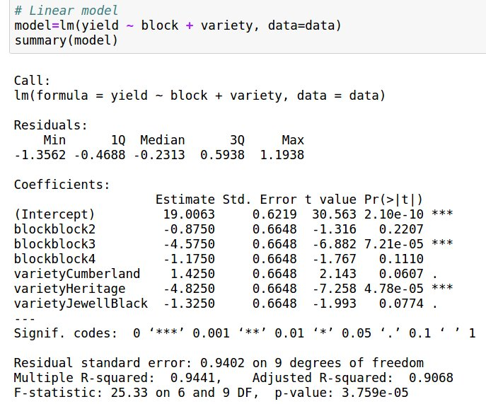
Raspberry example (cont.)
Let’s start by fitting a model like normal
Fitting this model means we are trying to break up the yield and determine how much of it is due to the different components
  In this case, block and variety
The first things we’re interested in getting out are the coefficients and the residuals

Slide 11
Model output
Focus on this part for now

Slide 12
Coefficients
The coefficients are the best estimate of how much each model term affects the final value (yield)
Intercept – The baseline value
Coefficients – how much being in this category changes that value

Slide 13
Coefficients
The coefficients are the best estimate of how much each model term affects the final value (yield)
P-values: Is this coefficient significantly different from zero

Slide 14
How a model sees the coefficients
Note: Although this is laid out similar to an incidence matrix, it’s slightly different
Model Summary
Data table
Model view
intercept | block1 | block2 | block3 | block4 | Anne | Cumberland | Heritage | JewellBlack
Notes:
Technically, the matrix we’re going to fill out is the result of multiplying the incidence matrix by the model coefficients, but that’s a little too deep into the math of regression for what I want this class to focus on.

Slide 15
How a model sees the coefficients
Model Summary
Data table
Model view
intercept | block1 | block2 | block3 | block4 | Anne | Cumberland | Heritage | JewellBlack
One level of each factor is unnecessary

Slide 16
How a model sees the coefficients
Model Summary
Data table
Model view
intercept | block1 | block2 | block3 | block4 | Anne | Cumberland | Heritage | JewellBlack
Intercept is the same for everything

Slide 17
How a model sees the coefficients
Model Summary
Data table
Model view
intercept | block1 | block2 | block3 | block4 | Anne | Cumberland | Heritage | JewellBlack
19.0
19.0
19.0
19.0
19.0
Intercept is the same for everything

Slide 18
How a model sees the coefficients
Model Summary
Data table
Model view
intercept | block1 | block2 | block3 | block4 | Anne | Cumberland | Heritage | JewellBlack
19.0
19.0
19.0
19.0
19.0
Other factors filled in based on whether or not they apply to that row of data

Slide 19
How a model sees the coefficients
Model Summary
Data table
Model view
intercept | block1 | block2 | block3 | block4 | Anne | Cumberland | Heritage | JewellBlack
19.0 |  | 0 | 0 | 0 |  | 0 | -4.8 | 0
19.0
19.0
19.0
19.0
Other factors filled in based on whether or not they apply to that row of data

Slide 20
How a model sees the coefficients
Model Summary
Data table
Model view
intercept | block1 | block2 | block3 | block4 | Anne | Cumberland | Heritage | JewellBlack
19.0 |  | 0 | 0 | 0 |  | 0 | -4.8 | 0
19.0 |  | 0 | 0 | 0 |  | 0 | 0 | 0
19.0
19.0
19.0
Other factors filled in based on whether or not they apply to that row of data

Slide 21
Exercise: Fill out the table
Model Summary
Data table
Model view
intercept | block1 | block2 | block3 | block4 | Anne | Cumberland | Heritage | JewellBlack
19.0 |  | 0 | 0 | 0 |  | 0 | -4.8 | 0
19.0 |  | 0 | 0 | 0 |  | 0 | 0 | 0
19.0
19.0
19.0
What values will go in these rows?

Slide 22
How a model sees the coefficients
Model Summary
Data table
Model view
intercept | block1 | block2 | block3 | block4 | Anne | Cumberland | Heritage | JewellBlack
19.0 |  | 0 | 0 | 0 |  | 0 | -4.8 | 0
19.0 |  | 0 | 0 | 0 |  | 0 | 0 | 0
19.0 |  | 0 | 0 | 0 |  | 1.4 | 0 | 0
19.0 |  | 0 | 0 | 0 |  | 0 | 0 | -1.3
19.0 |  | -0.9 | 0 | 0 |  | 0 | 0 | -1.3
What values will go in these rows?

Slide 23
How a model sees the coefficients
Model Summary
Data table
From this, we can get the fitted value, the prediction based on the coefficients
Model view
intercept | block1 | block2 | block3 | block4 | Anne | Cumberland | Heritage | JewellBlack
19.0 |  | 0 | 0 | 0 |  | 0 | -4.8 | 0
19.0 |  | 0 | 0 | 0 |  | 0 | 0 | 0
19.0 |  | 0 | 0 | 0 |  | 1.4 | 0 | 0
19.0 |  | 0 | 0 | 0 |  | 0 | 0 | -1.3
19.0 |  | -0.9 | 0 | 0 |  | 0 | 0 | -1.3
Total
Notes:
The fitted value is just the sum of all model coefficients, including the intercept

Slide 24
How a model sees the coefficients
Model Summary
Data table
From this, we can get the fitted value, the prediction based on the coefficients
Model view
intercept | block1 | block2 | block3 | block4 | Anne | Cumberland | Heritage | JewellBlack
19.0 |  | 0 | 0 | 0 |  | 0 | -4.8 | 0
19.0 |  | 0 | 0 | 0 |  | 0 | 0 | 0
19.0 |  | 0 | 0 | 0 |  | 1.4 | 0 | 0
19.0 |  | 0 | 0 | 0 |  | 0 | 0 | -1.3
19.0 |  | -0.9 | 0 | 0 |  | 0 | 0 | -1.3
Total
14.2
19
20.4
17.7
16.8
The fitted value is just the sum of the intercept and all applicable coefficients
Notes:
The fitted value is just the sum of all model coefficients, including the intercept

Slide 25
How a model sees the coefficients
Model Summary
Data table
The fitted values are usually close to the actual values but not exact matches
Model view
intercept | block1 | block2 | block3 | block4 | Anne | Cumberland | Heritage | JewellBlack
19.0 |  | 0 | 0 | 0 |  | 0 | -4.8 | 0
19.0 |  | 0 | 0 | 0 |  | 0 | 0 | 0
19.0 |  | 0 | 0 | 0 |  | 1.4 | 0 | 0
19.0 |  | 0 | 0 | 0 |  | 0 | 0 | -1.3
19.0 |  | -0.9 | 0 | 0 |  | 0 | 0 | -1.3
Total | Actual
14.2 | 13.8
19 | 18.6
20.4 | 21.3
17.7 | 17.6
16.8 | 18.0
Notes:
The fitted value is just the sum of all model coefficients, including the intercept

Slide 26
How a model sees the coefficients
Model Summary
The difference between fitted and actual values is the “residual error,” or residuals
Data table
Model view
intercept | block1 | block2 | block3 | block4 | Anne | Cumberland | Heritage | JewellBlack
19.0 |  | 0 | 0 | 0 |  | 0 | -4.8 | 0
19.0 |  | 0 | 0 | 0 |  | 0 | 0 | 0
19.0 |  | 0 | 0 | 0 |  | 1.4 | 0 | 0
19.0 |  | 0 | 0 | 0 |  | 0 | 0 | -1.3
19.0 |  | -0.9 | 0 | 0 |  | 0 | 0 | -1.3
Total | Actual | Error
14.2 | 13.8 | 0.4
19 | 18.6 | 0.4
20.4 | 21.3 | -0.9
17.7 | 17.6 | 0.1
16.8 | 18.0 | -1.2
Notes:
The fitted value is just the sum of all model coefficients, including the intercept

Slide 27
Questions on statistical models?

Slide 28
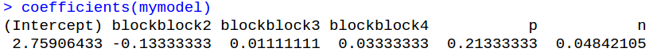
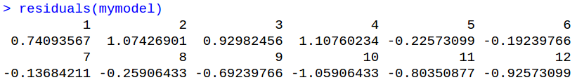
R tip: Linear regression utility functions
Because they are so important, R includes functions to easily work with coefficients and residuals
  coef() / coefficients() gets you the coefficients
  resid() / residuals() gets you the residuals

Slide 29
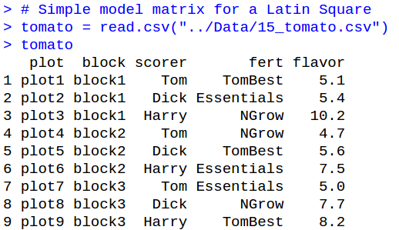
R tip: model.matrix()
You can see the incidence matrix R made for your data using model.matrix()

Slide 30
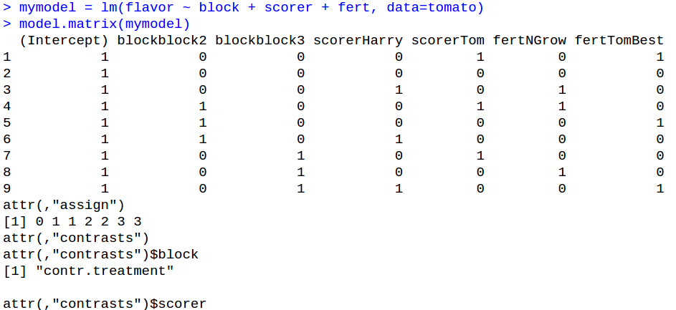
R tip: model.matrix()
Don’t worry about this stuff; outside the scope of this class
Incidence matrix of factor levels
Notes:
“Contrasts” are outside the scope of this class, but they’re basically the comparisons the linear regression model is making
I’m not going to explicitly hold you accountable for this (after all, you should be able to do this by hand if need be), but it could be useful to know

Slide 31
Questions on utility functions?

Slide 32
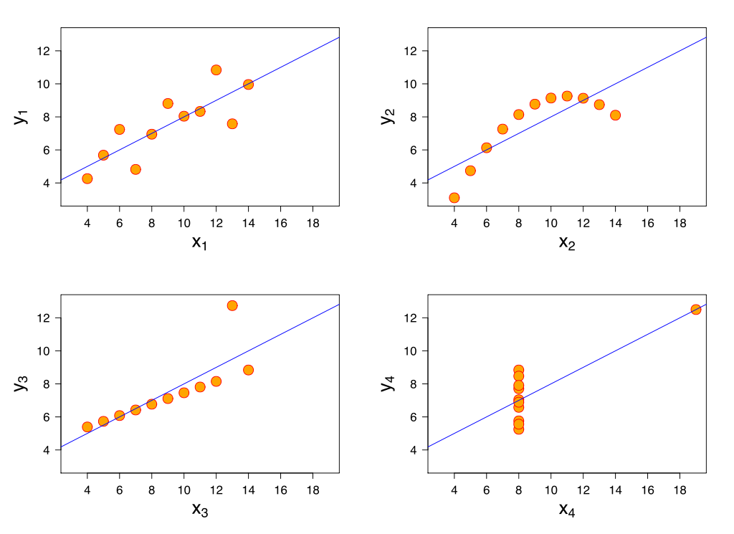
Limits of linear regression
Linear regression is powerful but not perfect
These four datasets all have the same regression line
  Also mean, variance, & correlation
  Always look at your data
Wikimedia (Shultz), based on Anscombe 1973, Am Stat 27:17

Slide 33
Assumptions of linear regression
Linear regression has similar assumptions to ANOVA
  Linear relationship between dependent and independent variables
  No multicollinearity
  Residuals are normally distributed
  Residuals are uncorrelated
  Homoscedasticity
Shared with ANOVA

Slide 34
Linear regression assumption # 1
Linearity of the relationship
Linear regression assumes all independent variables have a linear relationship with the dependent variable.
If this is not true, you will get an incorrect answer
  Sometimes even a highly significant one
Notes:
Generalized linear models can handle nonlinear relationships with data so long as you can turn it into a linear operation on a nonlinear function. We don’t have time to go over that in this class, though it may get mentioned a bit later

Slide 35
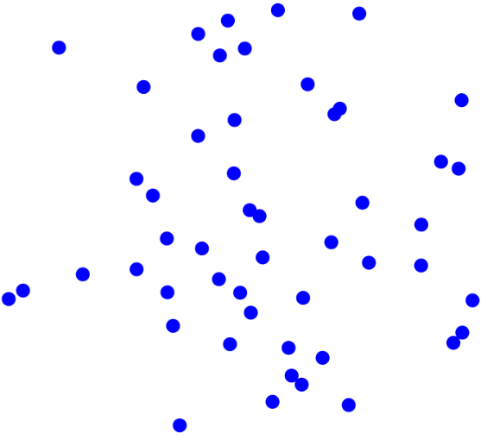
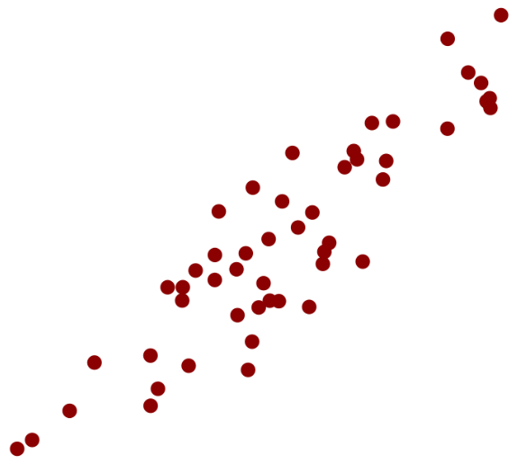
Linear regression assumption # 2
No multicollinearity (= independence)
Linear regression assumes the independent variables are uncorrelated with each other
If correlation among them exists (“multicollinearity”), it can throw off the trustworthiness of results
  Worst case is perfect correlation, which causes singularities
Little/no collinearity
X₂
X₁
Strong collinearity
X₂
X₁
Notes:
Again, there are ways to handle this. They involve transformation of your X variables and are pretty much beyond the scope of our class. For now, your best bet is to figure out if some of your X variables are correlated and drop one of them. (Usually determined by whichever one is less significantly associated with the data when tested without the other.)
Important to note that this is correlation among just the X variables. Doesn’t have anything to do with Y.

Slide 36
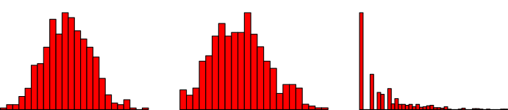
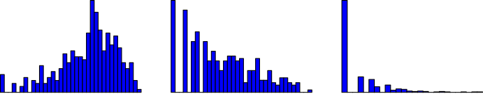
Linear regression assumption # 3
Residuals are normally distributed
Linear regression assumes the residuals are (roughly) normally distributed
If they aren’t, you may need to apply a transformation (eg, log) or use a more advanced regression method
Good
Poor
Bad
Abysmal
Notes:
Important to remember: regression assumes the _residuals_ are normally distributed, not the raw data. Highly skewed raw data often results in highly skewed residuals, but not always (depending on the model you fit), so always check the residuals themselves.

Slide 37
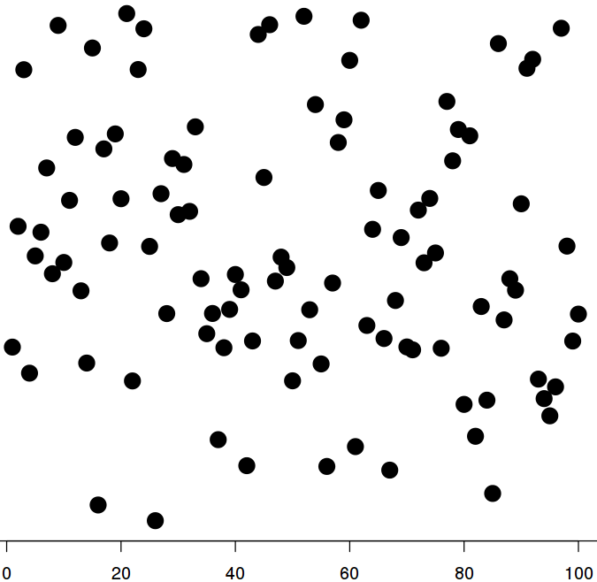
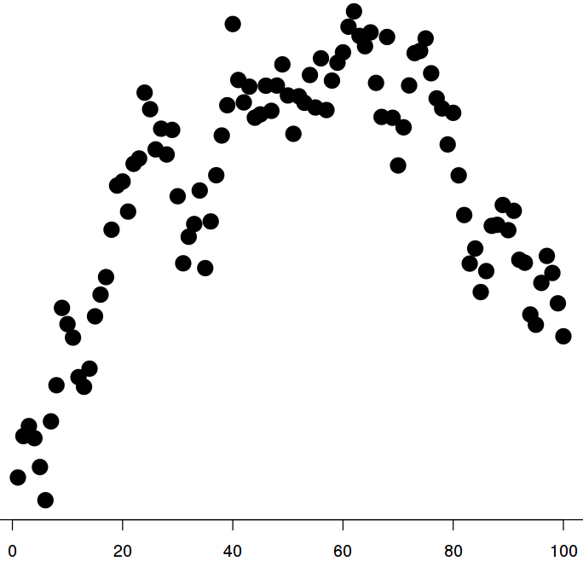
Linear regression assumption # 4
Residuals are uncorrelated
Linear regression assumes the residuals are uncorrelated with each other.
  By implication, this also means the original data is uncorrelated, but this is harder to see because of the effect of your X variables
Note: This assumption is almost always violated in agricultural experiments
Uncorrelated
Correlated
Notes:
Because violations of this are so common, many methods have been devised to deal with it. Most of these are beyond the scope of our class, but we will deal with a few of them later on.
It may be more accurate to say that ag data initially violates this assumption, and a lot of our designs and such are meant to correct it back.

Slide 38
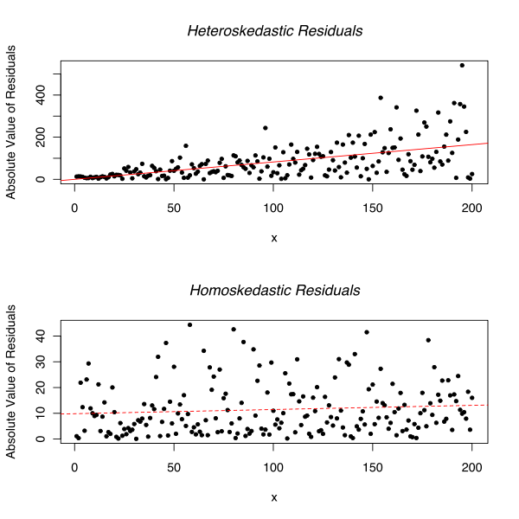
Linear regression assumption # 5
Homoscedasticity
Finally, linear regression assumes that the errors are “homoscedastic”, meaning they all have the same variance
Homoscedastic
Heteroscedastic

Slide 39
Linear regression assumptions
No dataset perfectly fits every one of these assumptions
However, many times you can get “close enough” to get a reasonable analysis
Severe violations, however, can cause problems and must be guarded against

Slide 40
Questions on linear regression assumptions?

Slide 41
The value of residuals
Because your residuals are everything you can’t explain, they are extremely useful for diagnosing problems with your model
  Outliers
  Violations of assumptions
  Excessive leverage (will explain in a bit)
  Etc.
Because they are so useful, R includes several default diagnostic plots to check them

Slide 42

R diagnostic plots
To see your diagnostics, all you have to do is plot the model
Four diagnostic plots will be output by default
  When working interactively (e.g., in Rstudio or the command-line), they’re plotted one at a time
  Press “enter” to move between them

Slide 43
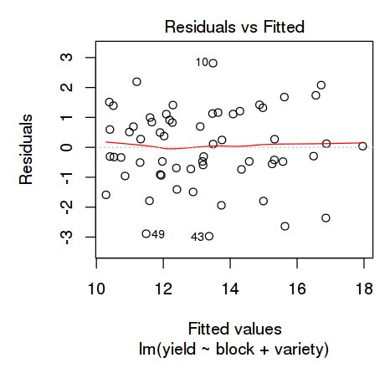
Diagnostic plot 1:
Residuals versus Fitted
The first plot shows your fitted values versus the residuals
The idea is to look for any outliers or patterns
  R labels the most extreme values (default 3) to make them easy to find
3 most extreme points
Notes:
The labels on the plot correspond to the row labels, which in this case is just the row number

Slide 44
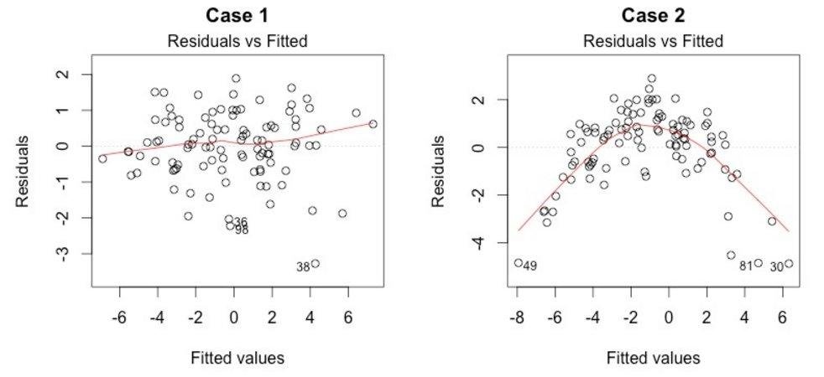
Diagnostic plot 1:
Residuals versus Fitted
Fitted versus residual plots are also good to identify patterns
No strong patterns
http://data.library.virginia.edu/diagnostic-plots/
Notes:
The labels on the plot correspond to the row labels, which in this case is just the row number

Slide 45
Diagnostic plot 1:
Residuals versus Fitted
Fitted versus residual plots are also good to identify patterns
No strong patterns
Very suspicious pattern
http://data.library.virginia.edu/diagnostic-plots/
Notes:
The labels on the plot correspond to the row labels, which in this case is just the row number

Slide 46
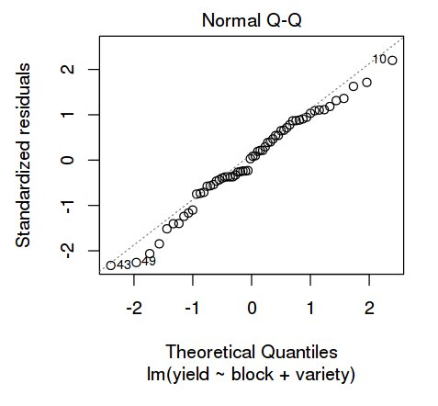
Diagnostic plot 2:
Quantile-Quantile plot
A little noise, but nothing big
A quantile-quantile plot shows the (sorted) residuals plotted against what you’d expect from chance
  Residuals should be normally distributed around a mean of 0
Any significant/systematic deviations from the dashed line may be problematic
Actual
Theoretical
Notes:
The labels on the plot correspond to the row labels, which in this case is just the row number
Importantly, this is a Q-Q plot of _residuals_, not p-values. Residuals should be exactly along the line, whereas you want p-values to tick up at the end. (Including this for anyone who’s used a Q-Q plot for GWAS analysis, which is different from how we’re using it here.)

Slide 47
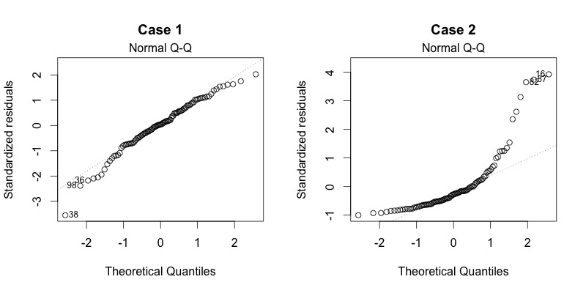
Diagnostic plot 2:
Quantile-Quantile plot
What to look out for:
Outlier value
http://data.library.virginia.edu/diagnostic-plots/
Notes:
Notice that R only flagged the most extreme ones on the right, but those are far from the only problems.

Slide 48
Diagnostic plot 2:
Quantile-Quantile plot
What to look out for:
Systematic departures from expected values
Outlier value
http://data.library.virginia.edu/diagnostic-plots/
Notes:
Notice that R only flagged the most extreme ones on the right, but those are far from the only problems.

Slide 49
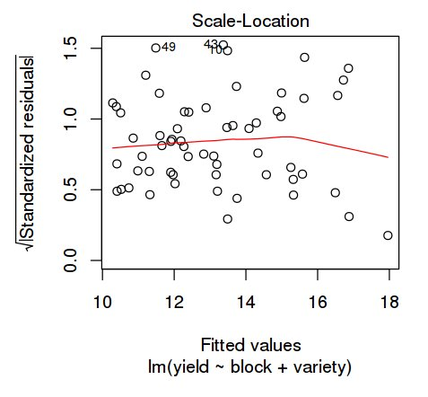
Diagnostic plot 3:
Scale-location plot
Scale-location plots use “standardized” residuals to look for homoscedasticity (= equal variance)
  Standardized = scaled to the expected standard deviation
Should have a roughly horizontal line with a random spread of points around it
Notes:
“Standardized” in this case is in the same sense of a standard-normal distribution, which is defined as a normal distribution with a mean of 0 and a s.d. of 1. A standardized residual of 2 means that the residual is 2 standard deviations above what you’d expect. R uses the square root of the absolute-value of the deviation because it apparently reduces the skewness more.

Slide 50
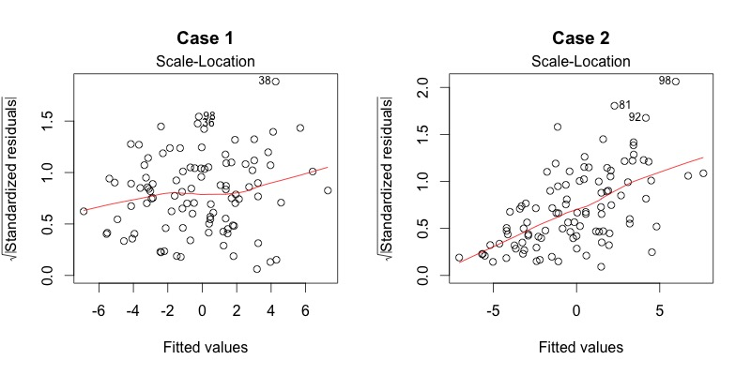
Diagnostic plot 3:
Scale-location plot
What to look out for:
No apparent issues
http://data.library.virginia.edu/diagnostic-plots/
Notes:
The plot on the left seems to be a roughly random spread around a roughly horizontal line, whereas the one on the right has a definite problem with the variance increasing (and thus violating the homoscedasticity assumption)

Slide 51
Diagnostic plot 3:
Scale-location plot
What to look out for:
No apparent issues
Problem
http://data.library.virginia.edu/diagnostic-plots/
Notes:
The plot on the left seems to be a roughly random spread around a roughly horizontal line, whereas the one on the right has a definite problem with the variance increasing (and thus violating the homoscedasticity assumption)

Slide 52
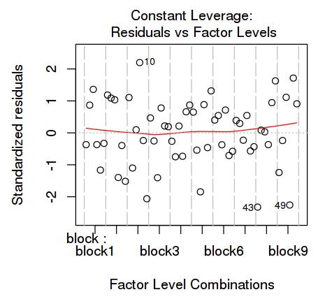
Diagnostic plot 4:
Residuals verses Leverage
This plot lets you look at “leverage”, or how much any individual point can influence the results
  May or may not appear as an outlier in the original data; these are the points that “buck the trend”
Again, look for any outliers or extreme values

Slide 53
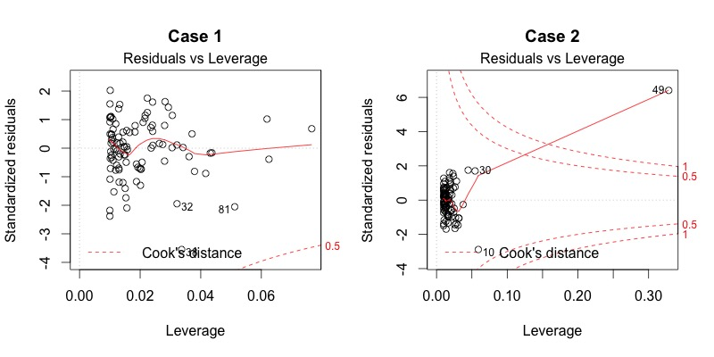
Diagnostic plot 4:
Residuals verses Leverage
Cook’s distance guidelines; anything outside these has excess leverage
This plot looks a little different with unbalanced/quantitative data
Look for problem points here
http://data.library.virginia.edu/diagnostic-plots/
Notes:
High-leverage points basically always occur in the upper-right or lower-right corners of the plot. The data on the left are well-behaved to the point where the Cook’s distance lines are barely visible, so even something in the corners wouldn’t have that much leverage.

Slide 54
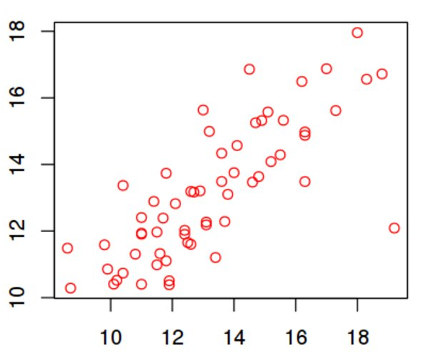
So what if you see a problem?
Outliers frequently mean there’s a problem with the data; best options are to either fix them or exclude them.
Patterns usually mean there’s something you’re not capturing in your model and you should change it
Notes:
Ways of changing your model include log-transforming the data, adding a quadratic term, including additional covariates, etc.

Slide 55
Questions on basic diagnostics?

Slide 56
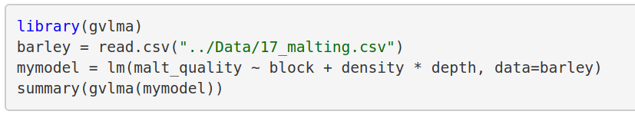
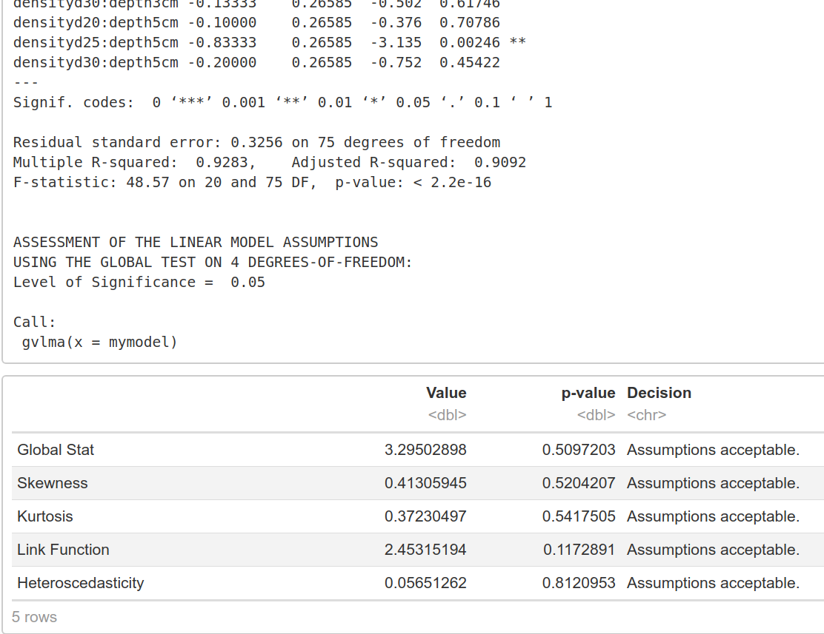
R function: gvlma()
GVLMA = Global Validation of
Linear Model Assumptions
The gvlma() function in the gvlma package can quickly test (most) linear regression assumptions for you
All assumptions met
(this time)
Notes:
Note that the things its testing don’t quite line up against the assumptions we mentioned. Different way to get to the same result.

Slide 57
Interpreting gvlma() output
These tests (sort of) line up against our assumptions
  (Note that they don’t test uncorrelated variables)
Residuals uncorrelated
Normality of residuals
Linearity
Equal variance

Slide 58
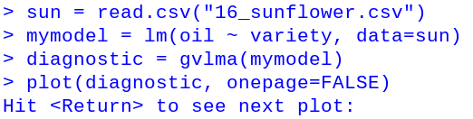
Plotting with gvlma()
You can also plot the outcome of gvlma()
Results are similar to basic plotting, but with:
  More plots looking at factor levels
  Histogram and scatterplots included
  Note: “Time sequence” usually means the order the data is in.
So doesn’t try to cram everything into a single plot

Slide 59

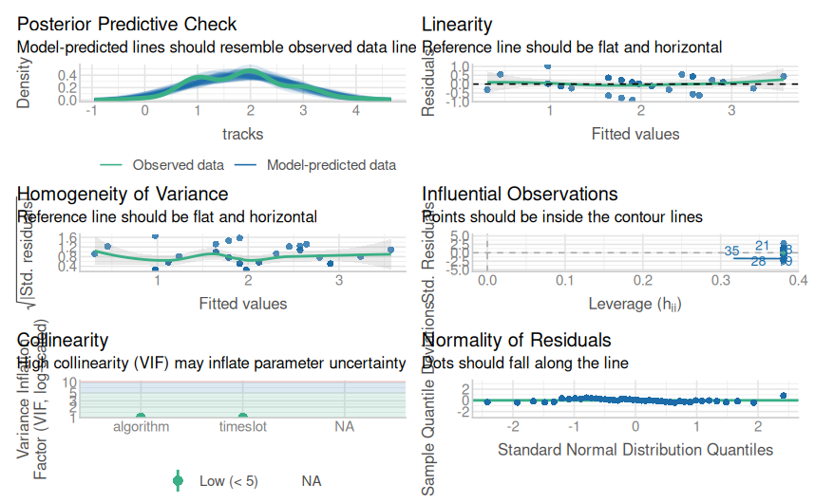
Alternative: check_model()
The check_model() function in the performance package also runs tests and gives graphical output (& guidance)
Notes:
One good things is that check_model() also works with mixed models, which we will get to later in the semester. Doesn’t give you a convenient p-value to judge by, though.
The performance package also has a bunch of functions to check individual aspects, but this is a nice wrapper to get the most common/important ones.
I haven’t gone through this one a ton, so less familiar with it still

Slide 60

In-class exercise:
Model diagnostics
Download “15_sunflower.csv” on sunflower oil content.
  Fit a model & check your assumptions
  Plot the diagnostics
  Do you see any outliers or other problems?
  If so, how would you solve them?

Slide 61
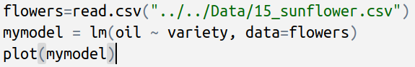
In-class exercise:
Model diagnostics
Code:

Slide 62
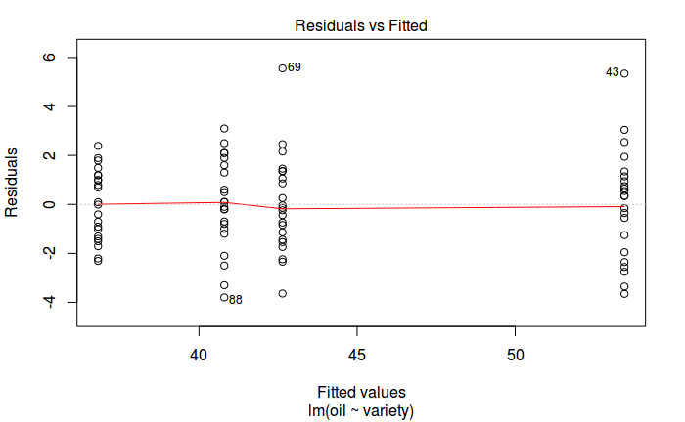
In-class exercise:
Model diagnostics
Possible outliers

Slide 63
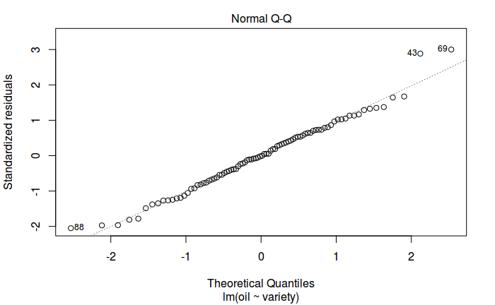
In-class exercise:
Model diagnostics

Slide 64
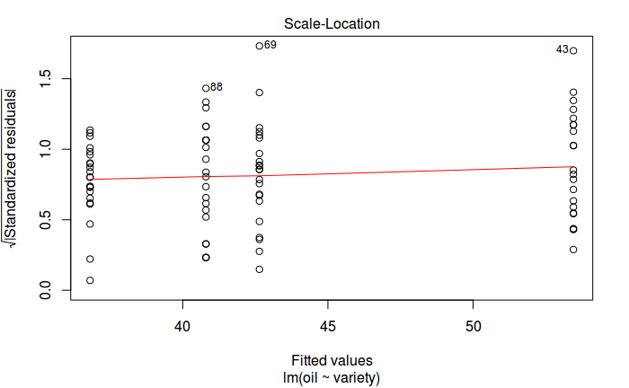
In-class exercise:
Model diagnostics

Slide 65
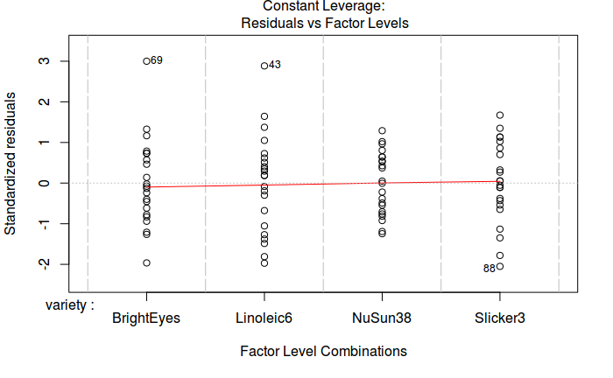
In-class exercise:
Model diagnostics

Slide 66
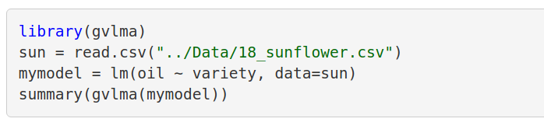
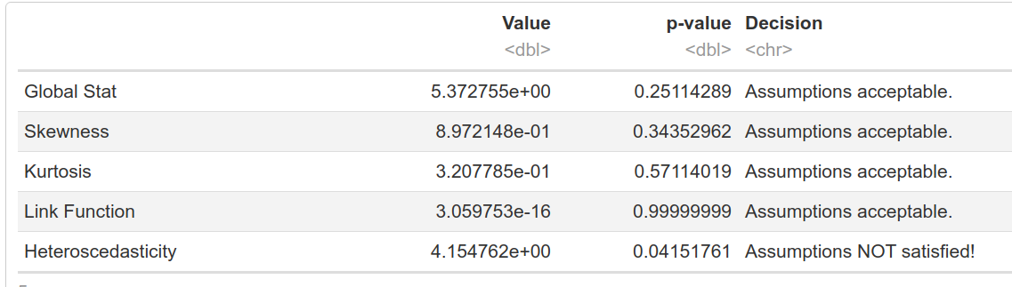
In-class exercise:
Model diagnostics
[…skipped model summary….]

Slide 67
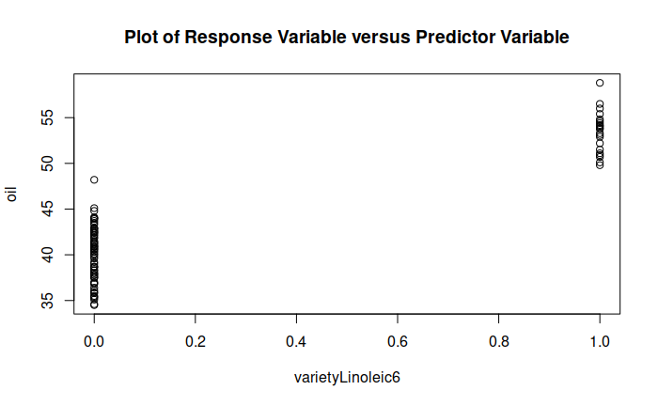
In-class exercise:
Model diagnostics
First several plots are looking at treatment levels

Slide 68
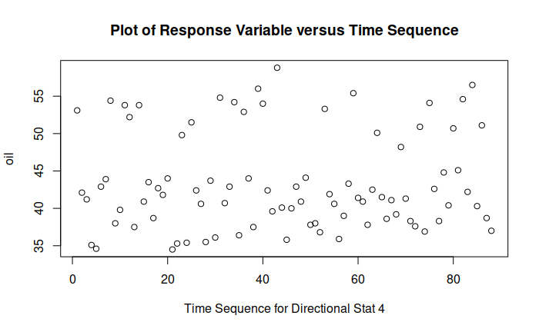
In-class exercise:
Model diagnostics
Next raw data (in order)

Slide 69
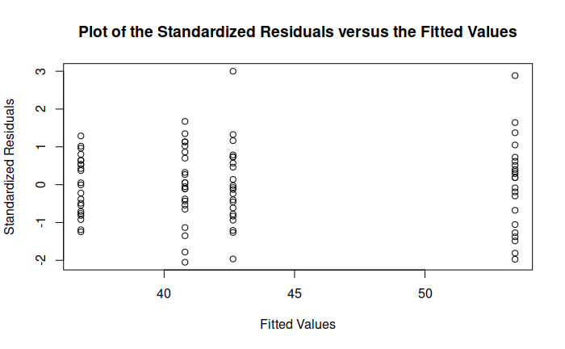
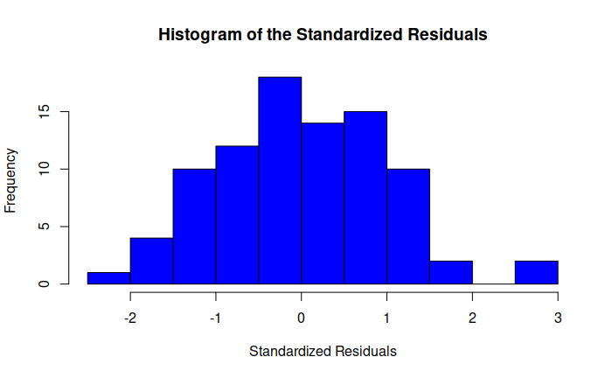
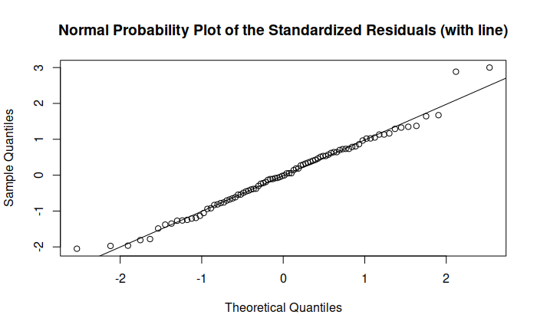
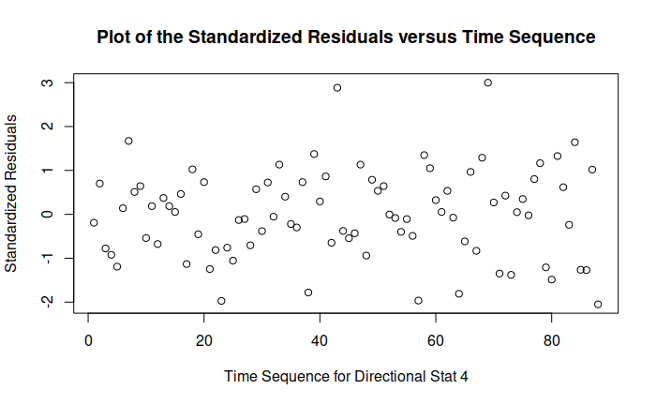
In-class exercise:
Model diagnostics
Fitted values vs residuals
Histogram
Next Residuals diagnostics
QQ plot
Residuals (in order)

Slide 70
Questions on model diagnostics?

